Slide 1
Sécurité en Profondeur

Slide 2
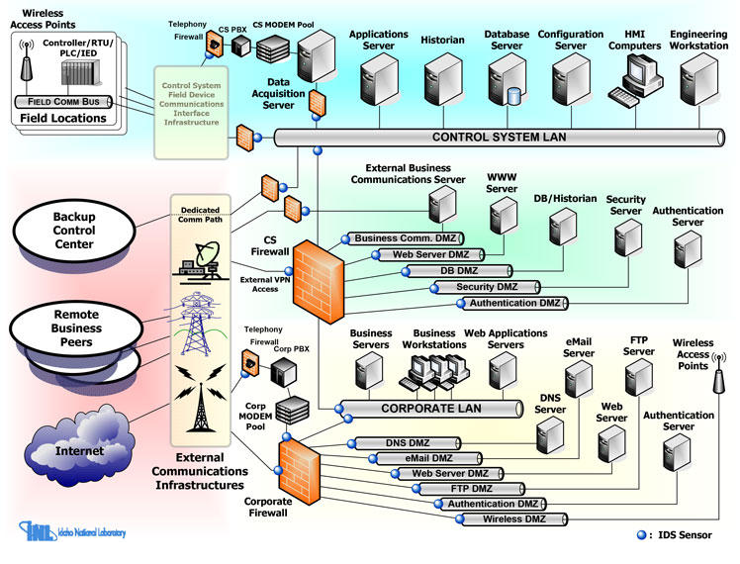
Notes:
https://www.forcepoint.com/fr/cyber-edu/defense-depth#:~:text=La%20d%C3%A9fense%20en%20profondeur%20(DEP,imm%C3%A9diatement%20pour%20d%C3%A9jouer%20une%20attaque.
https://rasoolirfan.com/2018/02/05/cyber-security-defense-in-depth-strategies/
https://www.energy.gov/sites/prod/files/oeprod/DocumentsandMedia/Defense_in_Depth_Strategies.pdf
https://www.fortinet.com/resources/cyberglossary/defense-in-depth
https://www.forcepoint.com/cyber-edu/defense-depth
https://www.imperva.com/learn/application-security/defense-in-depth/

Slide 3
Périmètre de Défense

Slide 4
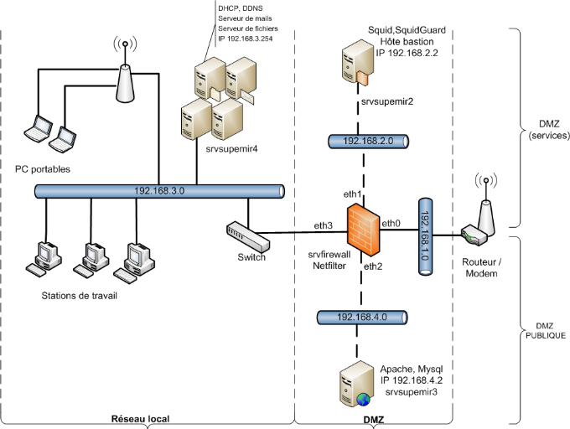
Notes:
https://www.networkdefenseblog.com/post/design-scenario-2-dmz-design
https://www.networkdefenseblog.com/post/design-scenario-2-dmz-design

Slide 5
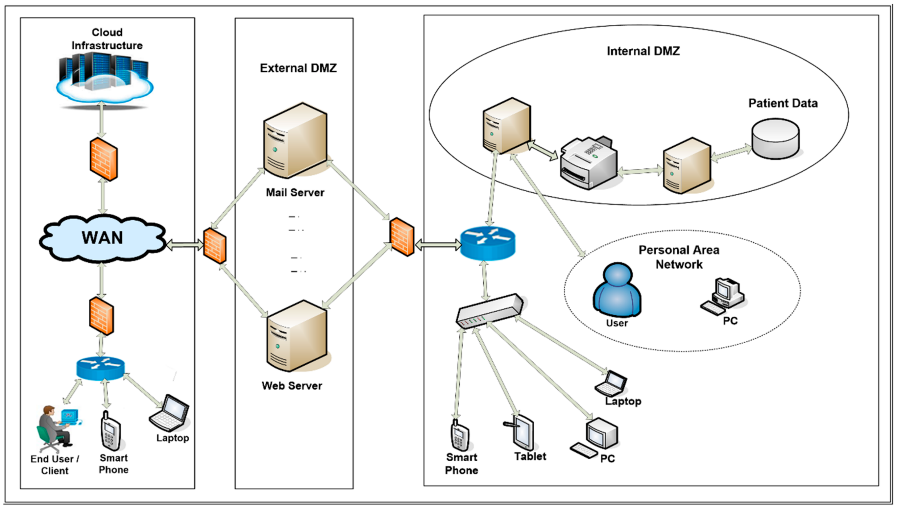

Slide 6
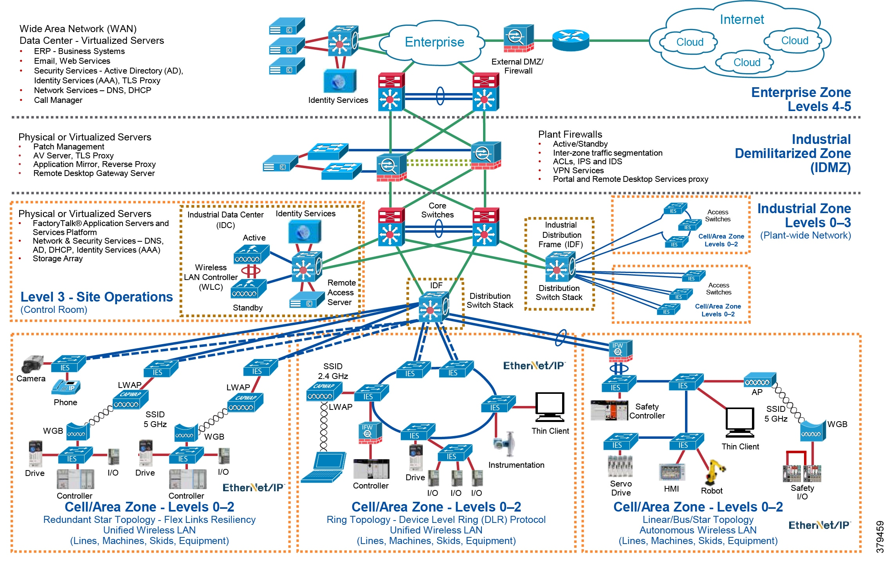
Notes:
https://www.cisco.com/c/en/us/td/docs/solutions/Verticals/CPwE/5-1/Network_Security/WP/CPwE-5-1-NetworkSecurity-WP/CPwE-5-1-NetworkSecurity-WP.html

Slide 7
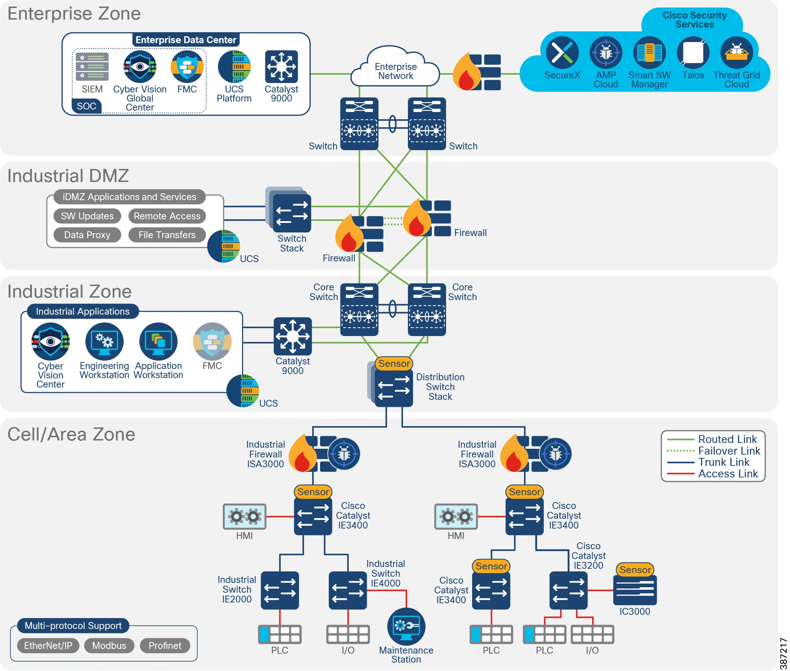
Notes:
https://www.cisco.com/c/en/us/td/docs/solutions/Verticals/Industrial_Automation/IA_Horizontal/IA_Security/IA_Security_DG/IA_Security_DG.html

